Slide 1
Data
Analysis & Preprocessing
Eng- Mohamed Khaled Idris
Eng- Mayar Swilam

Slide 2
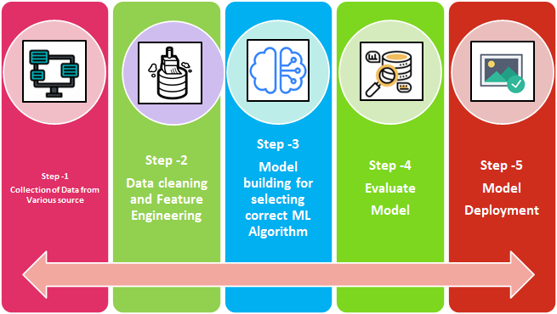
Review:

Slide 3
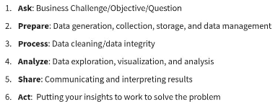
What is Data Analysis ?
(Google Data Analytics)

Slide 4
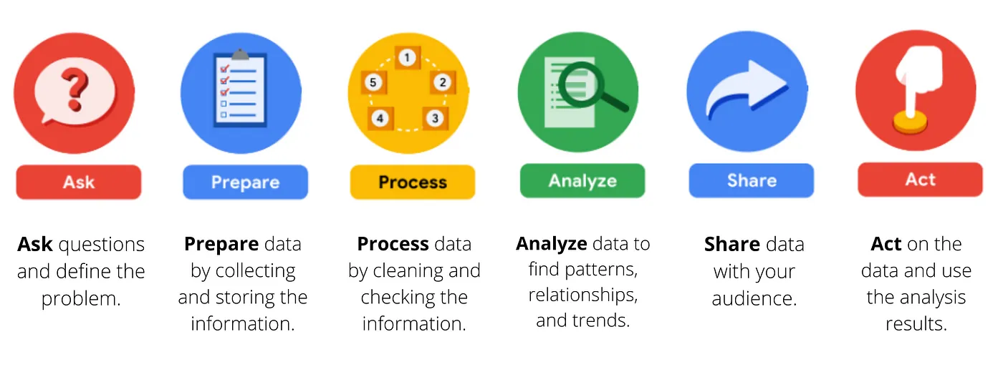

Slide 5
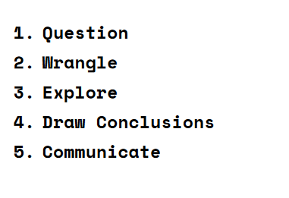
In other words
(UDACITY)

Slide 6
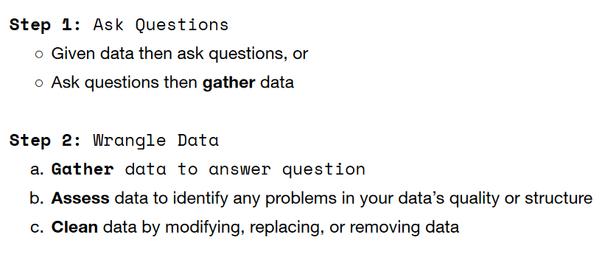

Slide 7
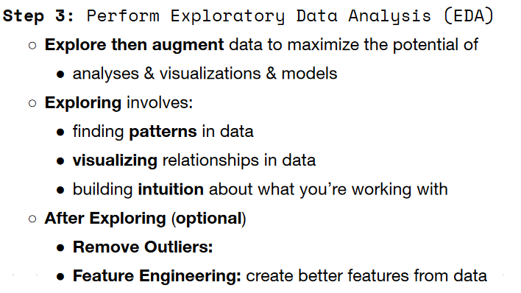

Slide 8
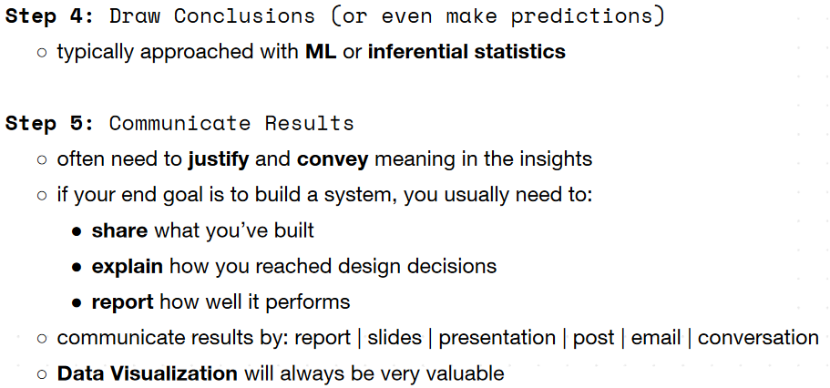

Slide 9
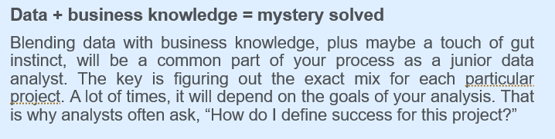

Slide 10
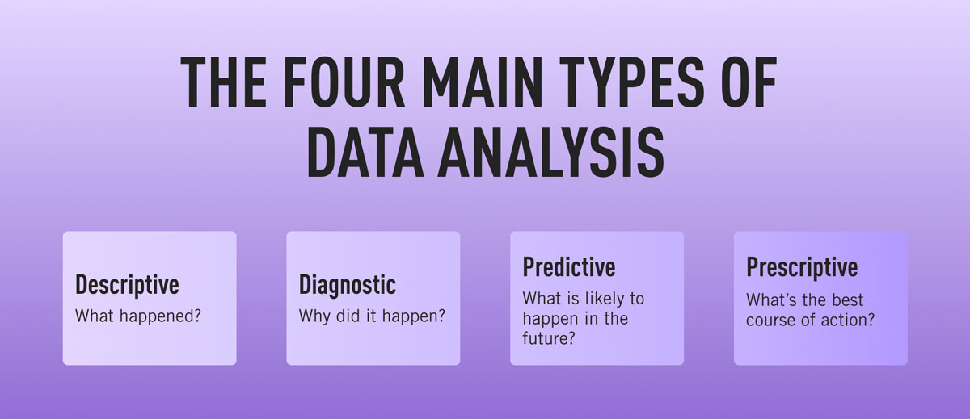
Types of Analysis

Slide 11
That brings us into “Data Quality”

Slide 12
What is the dimensions of “Data Quality” ?
Data Quality is a measurement of the degree to which data is fit for purpose. Good data quality generates trust in data. Data Quality Dimensions are a measurement of a specific attribute of a data's quality.

Slide 13
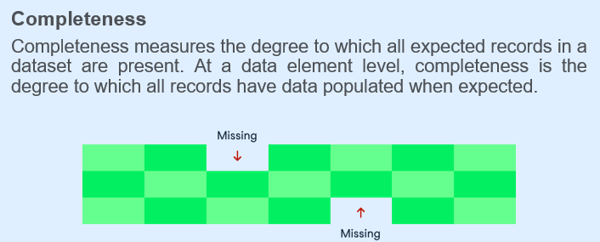
Completeness

Slide 14
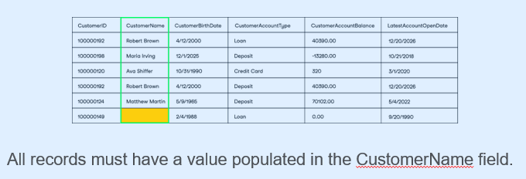
Example

Slide 15
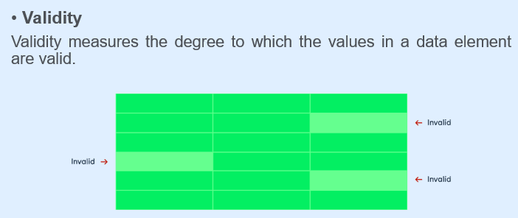
Validity

Slide 16
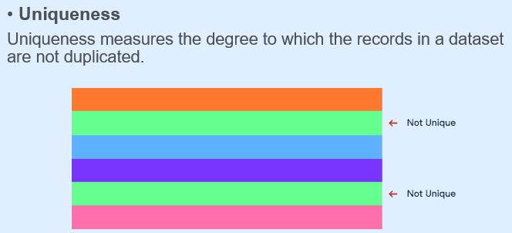
Uniqueness

Slide 17
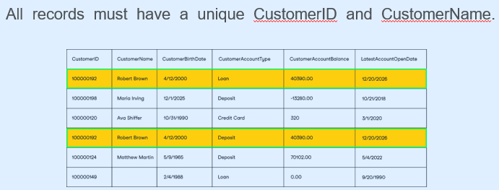
Example

Slide 18
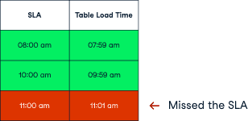
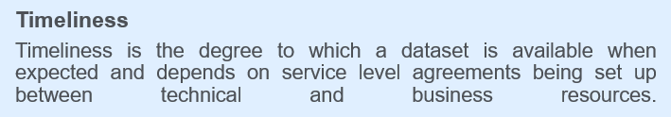
Timeliness

Slide 19
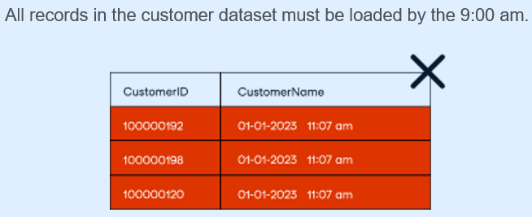
Example

Slide 20
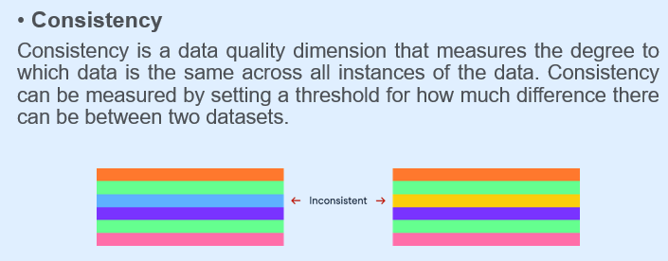
Consistency

Slide 21
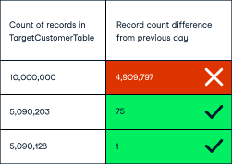
Example

Slide 22
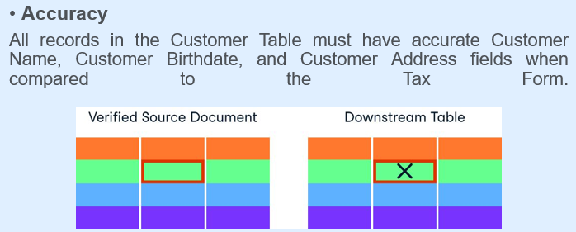
Accuracy

Slide 23
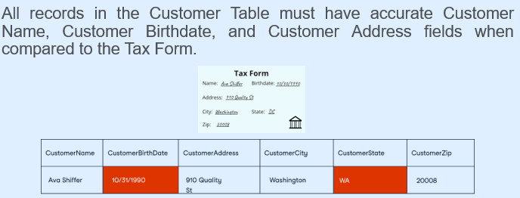
Example

Slide 24
Welcome to the world of
Data Cleaning & data preprocessing

Slide 25
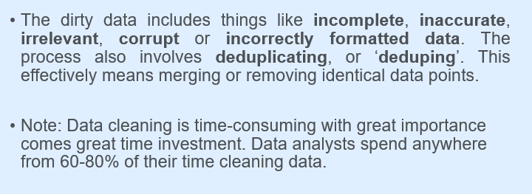

Slide 26
WARNING !
The following concepts and operations will be applied are NOT SEQUENTIAL

Slide 27
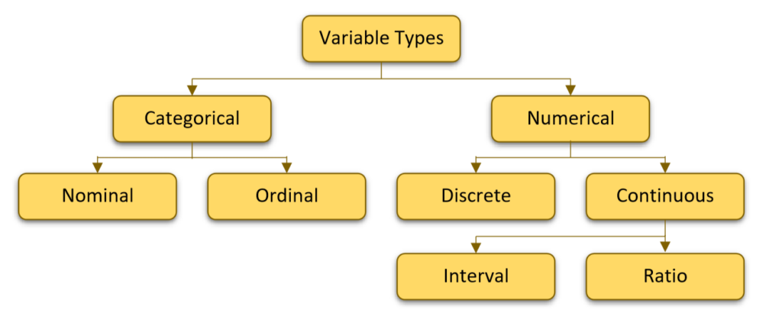
Types of Attributes

Slide 28
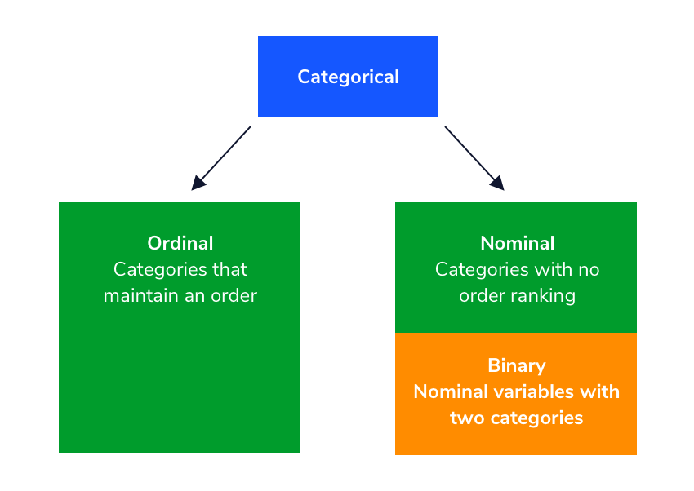
Categorical: Nominal VS. Ordinal

Slide 29
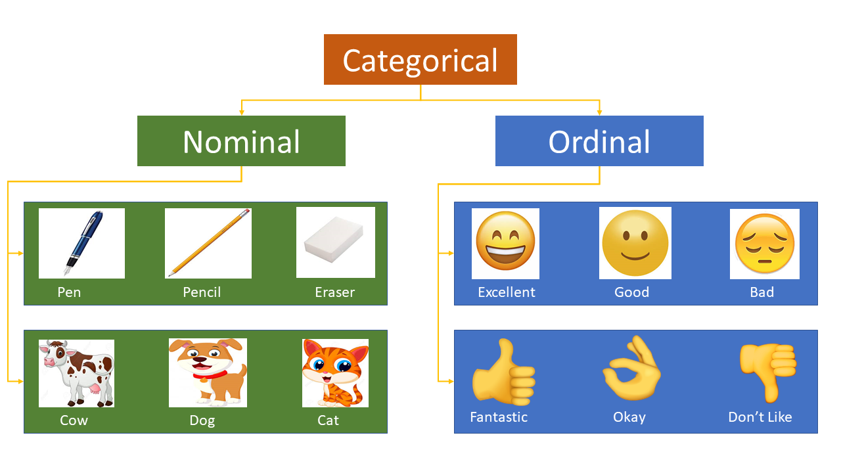

Slide 30
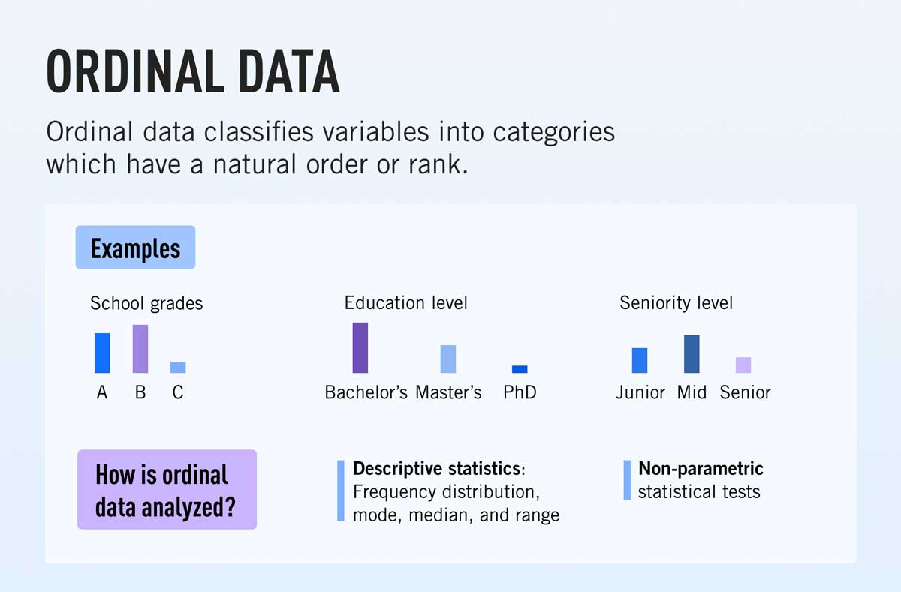
Ordinal Attribute

Slide 31
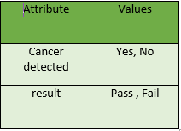
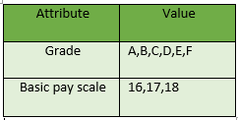
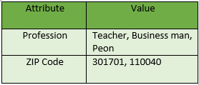
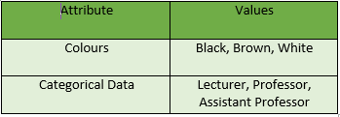
Test your Understanding

Slide 32
Does Computer Understand text ?

Slide 33
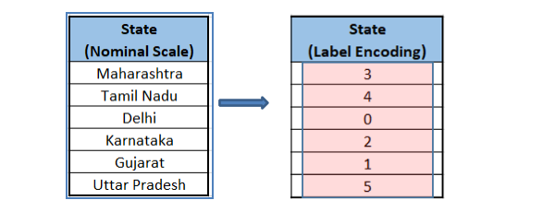
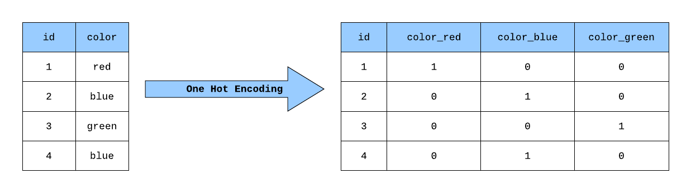
First:
Label Encoding & One-hot Encoding

Slide 34
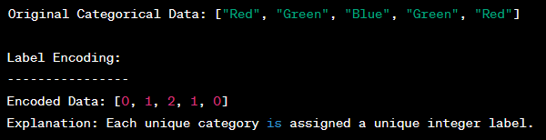
Label Encoding

Slide 35
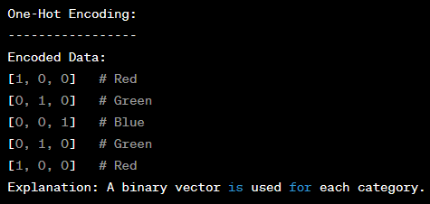
ONE-HOT Encoding

Slide 36
Label Encoding vs. One-Hot Encoding
Label Encoding assigns a unique integer label to each category. It results in a single column of integers, which may imply ordinal relationships between the labels that may not exist.
One-Hot Encoding represents each category as a binary vector. It creates multiple columns, one for each category, with binary values (0 or 1) indicating the presence or absence of a category.

Slide 37
What is outliers ?
Outliers are data points that significantly deviate from the rest of the data in a dataset.
They can be unusually high or low values compared to the majority of the data points.
Outliers can arise due to various reasons, including measurement errors, data entry mistakes, or genuine extreme values in the underlying phenomenon being studied.
Outliers can have a significant impact on statistical analyses and machine learning models, potentially leading to biased or inaccurate results
37

Slide 38
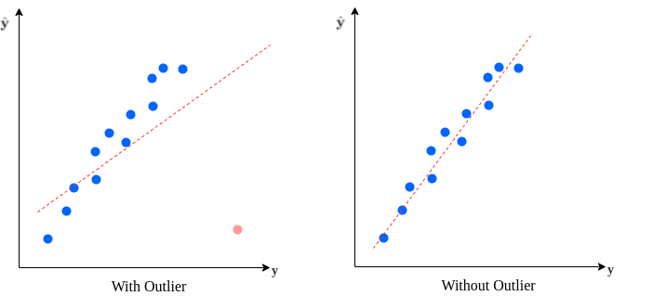
Outliers (Scatter Plot)

Slide 39
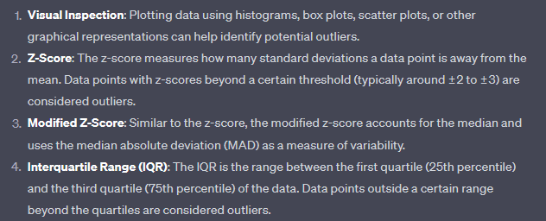
How to detect outliers?

Slide 40
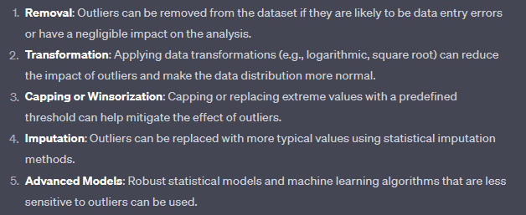
How to Handle Outliers?

Slide 41
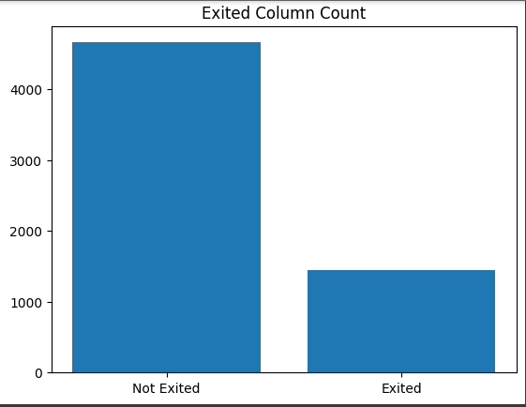
IMBALANCED DATASETS
(Bar Charts)

Slide 42
What is Imbalancing ?
An imbalanced dataset refers to a dataset in which the distribution of classes (categories or labels) is significantly skewed or uneven.
In other words, one class has a much larger number of instances compared to one or more other classes.
This imbalance can pose challenges for various machine learning algorithms and statistical analyses, particularly those that assume a roughly equal distribution of classes.

Slide 43
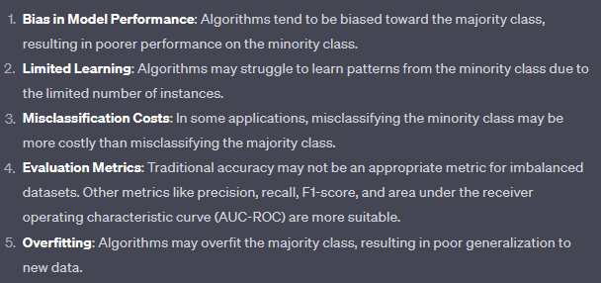
What is the challenges against Imbalanced datasets ?

Slide 44
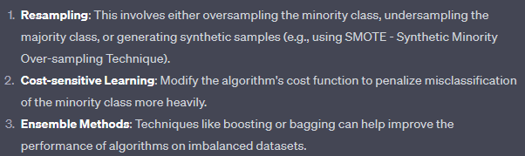
Solutions

Slide 45
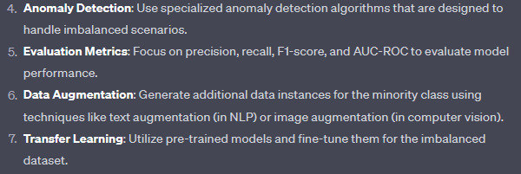
Solutions (Cont.)

Slide 46
Synthetic-Minority Oversampling Technique (SMOTE Oversampling)
It is a popular technique used to address the issue of class imbalance in machine learning datasets.
SMOTE is specifically designed to increase the representation of the minority class by generating synthetic samples.
In a class-imbalanced dataset, the minority class (i.e., the class with fewer instances) is often underrepresented, which can lead to biased model performance and poor generalization.

Slide 47
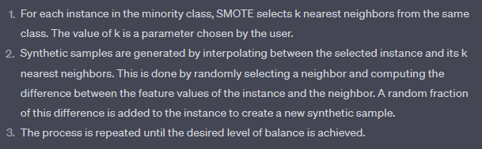
SMOTE Algorithm

Slide 48
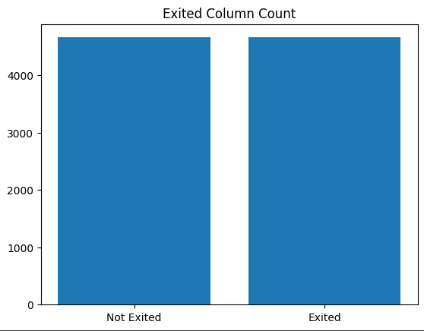
Before and After balancing

Slide 49
Normalization & Scaling
Normalization and scaling are techniques used in data preprocessing to transform the features (variables) of a dataset into a specific range or distribution.
These techniques are important for preparing data before feeding it into machine learning algorithms, as they can improve the performance and convergence of various models.

Slide 50
Normalization
Normalization involves transforming the entire dataset so that each feature has a similar scale.
The goal is to bring all features to a similar range, typically between 0 and 1.
This is particularly useful for algorithms that rely on distances or gradients, such as k-nearest neighbors (KNN) and gradient descent-based optimization algorithms.

Slide 51
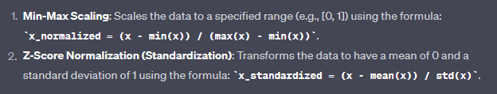
Types of Normalization

Slide 52
Scaling
Scaling, on the other hand, focuses on adjusting the range of features without necessarily changing their distribution or statistical properties.
Scaling can be important for algorithms that use distance measures but don't necessarily require a specific range for input features.

Slide 53
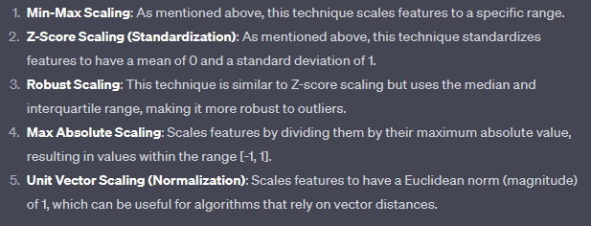
Types of Scaling

Slide 54
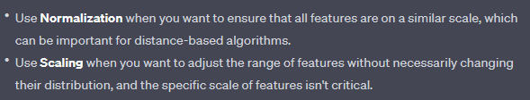
Normalization VS. Scaling

Slide 55
Pearson Correlation
Pearson's correlation coefficient or Pearson's r, is a statistical measure that quantifies the linear relationship between two continuous variables.
It assesses how closely the data points of two variables align on a straight line. The coefficient ranges from -1 to 1, where:
A value of +1 indicates a perfect positive linear relationship, meaning that as one variable increases, the other also increases proportionally.
A value of -1 indicates a perfect negative linear relationship, meaning that as one variable increases, the other decreases proportionally.
A value of 0 indicates no linear relationship between the variables; they are independent of each other.

Slide 56
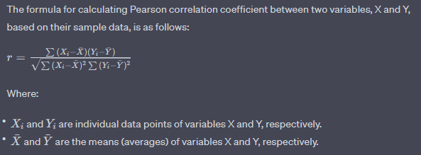
Pearson Correlation (Cont.)
In essence, Pearson correlation helps to determine if there is a consistent pattern in the way two variables change in relation to each other.
It's important to note that Pearson correlation specifically measures linear relationships, so if the relationship between the variables is not linear, the correlation coefficient may not accurately capture their association.

Slide 57
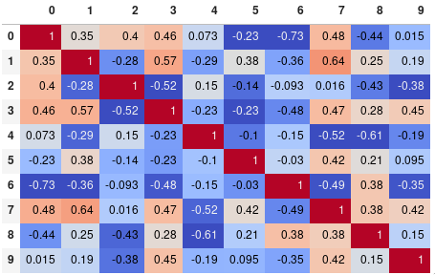
Pearson Correlation (Cont.)

Slide 58

Questions

Slide 59


Thank You

